Slide 1
Dynamic Payment Orchestration
Real-Time AI for Optimal Rail Selection

Slide 2
Problem Statment
The Modern payments ecosystem is fragmented. It relies on multiple, siloed payment rails like ACH, Wires, Cards and Zelle. Eacch operates with its own infrastructure, rules and processing speeds. This creates significant challenges.
High Failure Rates: Transactions often fail because the selected rail is unavailable, the transaction doesnt meet specific criteria, or network issue.
Processing Delays: When transaction fails, manual intervention is often required to retry it, leading to delays and poor customer experience.

Slide 3
Problem Statment (Contd...)
Operational Inefficiency: Businesses must build and maintain complex, custom logic to handle payment routing and failures, diverting resources from their core experiences.
Lack of Intelligent Optimization: Existing systems cannot dynamically select optimal payment rail in real-time based factors like urgency, transaction size, cost and network availability. There is no intelligent system to assess transaction intent and automatically retry a failed payment on more suitable rail.

Slide 4
Technical Solution
I propose an AI-Powered Unified Payments Core, a smart, self-learning orchestration layer that sits between a business’s system and payment networks.
This System acts as central intelligence hub that ingest payment request and uses AI engince to dynamically route, secure, and guarantee successful completion of transaction.

Slide 5
Core Components
Unifed API: A single point of integration for businesses to submit all payment requests.
Dynamic Routing Logic: The engine considers multi-layeres set of factors.
Transaction Intent: Urgency, value and customer preference.
Rail Status: Real-time availability and processing speeds of network.
Cost Optimization: Transaction fee for each potential rail.
Success Probability: Historical Data to predict likelihood of success.
Real-time Fraud & Compliance Score: Rist assessment for each transaction.

Slide 6
Core Component(Contd...)
Self-Learning AI decision Engine: It analyzes each transaction in real-time to select the optimal payment rail. The model contiuousy learns outcomes to improve decision-making over time.
Intelligent Fallback Mechanism: If transaction fails, the system automatically and instantly retries it on next best alternative based on reason for the initial failure.
Analytics & Insights Dashboard: A customer-facing portal providing deep insights into transaction success rates, costs, routing patterns and performance metrics.

Slide 7
Solution
Entry Point: A merchant’s application send standardized payment request to our secure API gateway.
Central Hub ( Self-Learning AI Decision Engine): The request passed to AI Decision Engine. The Engine coordinates with several real-time microservices.
Fraud & Compliance Engine: A new, dedicated service that performs real-time fraud scoring and checks transaction against AML, KYC and other regional rehulations.
Rail Status Monitor: Contiuously monitors health, uptime and processing speed of all integrated payment networks.
Cost & Rules Database: Contains fee structures, transaction limits, and operational rules for each payment rail.

Slide 8
Solution (Contd...)
Routing (Rail Connectors): Based on AI’s multi-factor decision, the engine routes the transaction to appropriaate Raail connector, which formats the data for chosen network.
Execution & Monitoring (Fallback Loop): The chosen rail attempts the transaction:
On Success: Confirmation is sent back to merchant.
On Failure: The failure reason is sent back to AI Decision Engine, which immediately re-evaluates and routes the transaction to next best rail, initiating fallback loop.
Unifies Ledger & Analytics: All final transaction statues aare recorded in unified ledger.

Slide 9
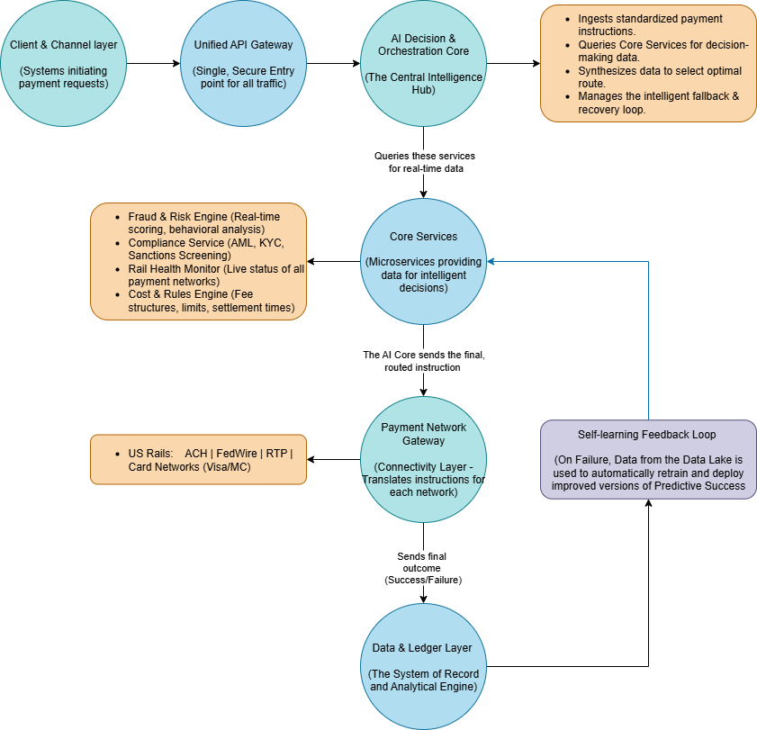
Solution Architecture

Slide 10
Real time Scenario
Use Case: Real-World Transaction Flow
Merchant: Modern Nest (Online Home Good Retailer)
Customer: Alex
Transaction: $450 for bookshelf
Time: Sunday, 10:00 PM (Outside of banking hours)
Goal: Instant confirmation at lowset possible cost.

Slide 11
Real time Scenario (Contd...)
Initiation: Alex clicks “Pay Now”. The request is sent to Unified Payment API Gatway.
Analysis: The AI engine instantly analyzes the transaction against rel-time data.
Fraud Score: Low Risk
Rail Status:
RTP network: UP
Card netword: UP
ACH: UP(but settlement is delayed unitl next business day)
Wire: DOWN
Cost Comparison:
ACH: $0.25
RTP: $0.30
Card: $11.35 (2.5% + $0.10)

Slide 12
Real time Scenario (Contd...)
AI Decision Logic:
ACH is cheapest but is not real-time, making it unsuitable for instant confirmation.
The Card Network is real-time but is significantly more expensive
RTP offers the best combination of Instant settlement and very low cost.
AI Decision:
Route Trannsaction via RTP network.

Slide 13
Real time Scenario (Contd...)
The Challenge - A Real-World Failure
Execution: The system attempts the $450 payment on the RTP Network.
FAILURE
Reason Code: AC04 - Account Closed
Problem: The customer's bank account is not enabled for RTP. In a traditional system, this results in a generic "Payment Failed" message and a lost sale.

Slide 14
Real time Scenario (Contd...)
The Solution - Intelligent Fallback & Recovery
The failure reason is instantly sent back to the AI Decision Engine.
AI Re-evaluation Logic:
The failure reason (AC04) is permanent for this rail. Retrying on RTP is pointless.
The AI immediately disqualifies RTP and re-evaluates the remaining options.
To save the sale with instant confirmation, the only viable option left is the Card Network.
AI DECISION: Instantly re-route the transaction via the Card Network.

Slide 15
Real time Scenario (Contd...)
The Outcome: A Saved Sale & A Smarter System
Business Outcome: The $450 sale is saved. The payment succeeds, and Alex gets an order confirmation. Modern Nest avoids cart abandonment.
System Outcome: The Unified Ledger records the entire transaction journey:
Initial Attempt: RTP (Failed)
Final Rail: Card Network (Success)
Final Cost: $11.35
The Self-Learning Loop: The AI model is automatically updated. It now knows that Alex’s bank account is not RTP-enabled. The next time Alex makes a purchase, the system will not even attempt RTP, making future checkouts faster and more efficient.

Slide 16
Novelty
The novelty lies in its creation of holisitic, self-learning and fully autonomous payment orchestration system.
Autonomous, Multi-factor Decisioning: Ai engine moves beyond static rules to consider dynamic blend of factors simultaneously.
Automated & Intelligent Fallback: The recobery system is fully automated. The intelligence is not just in retrying, but in choosing the next best alternative based on analysis of why first one falied.

